Slide 1
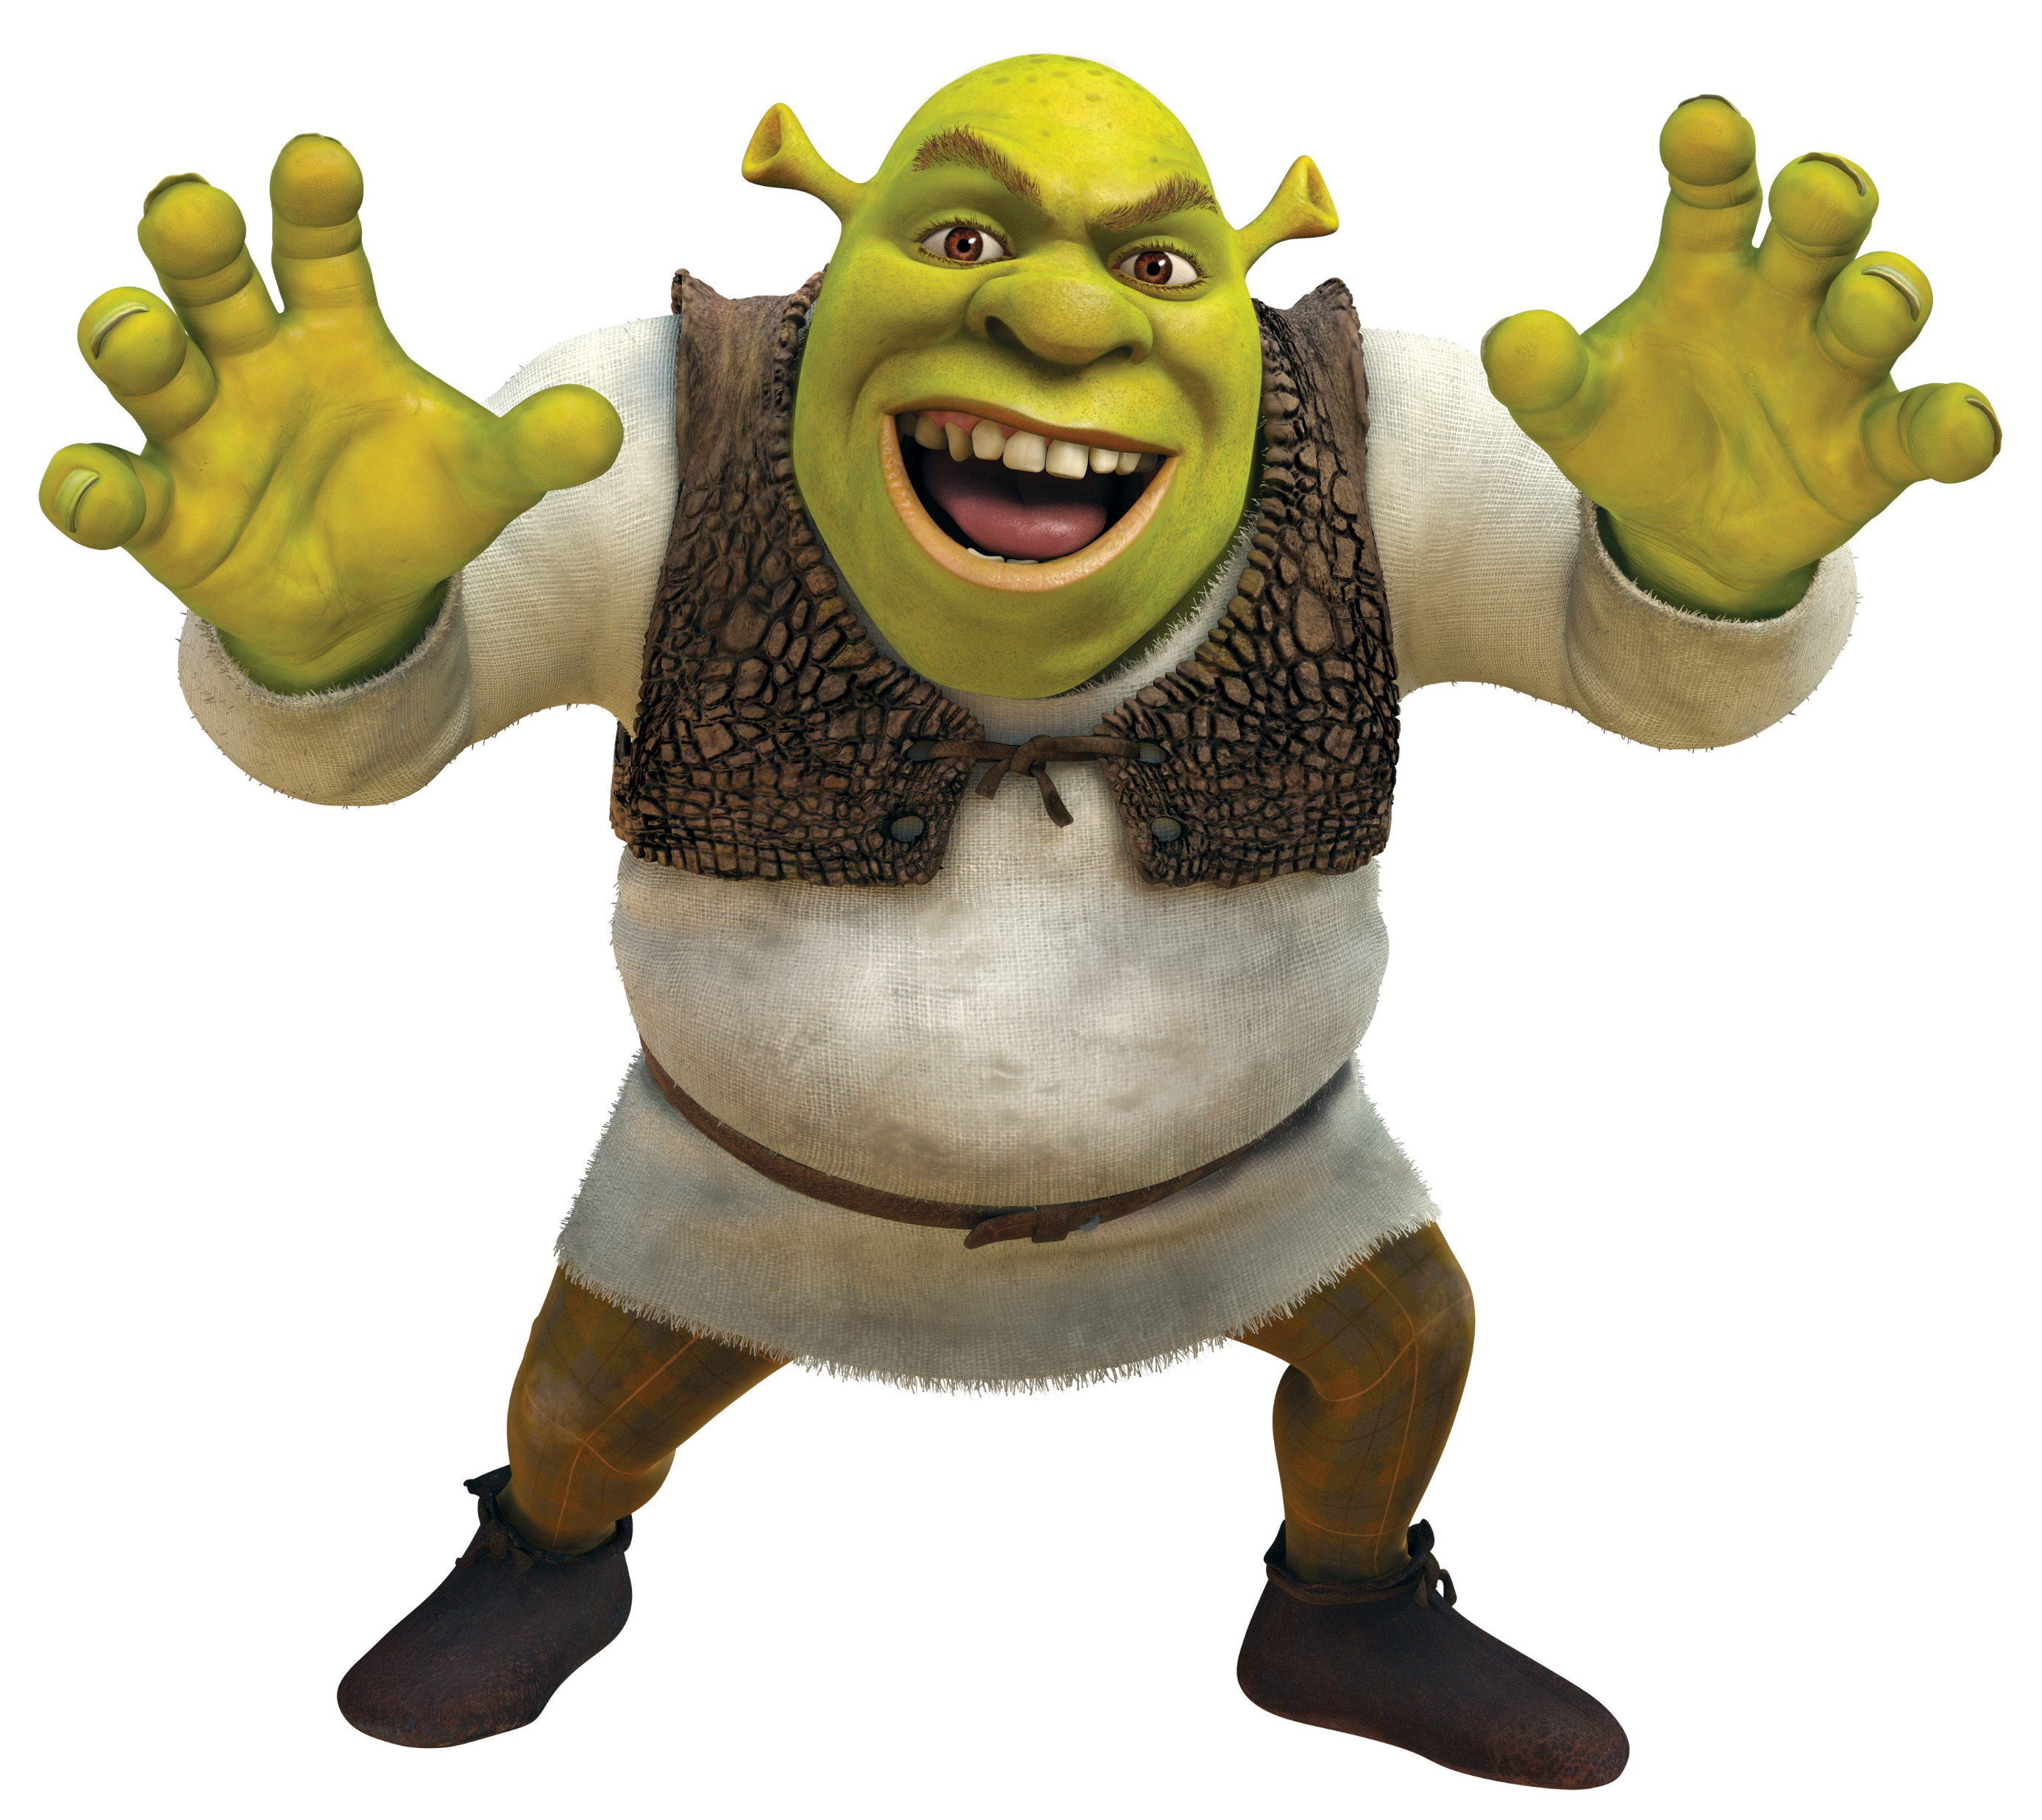
Day 1 – 11:30 Project Progress Report -Tympe-
Logan Schlick, Daniel Marin, Kyle Rimando, Sonny Pizzo, Shane Ghuste

Slide 2
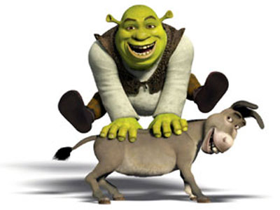
Front end progress…
Basic web design
Title, Start Button, layout for game
Basic skeleton of the website
Front end designers:
Daniel Marin
Sonny Pizzo

Slide 3
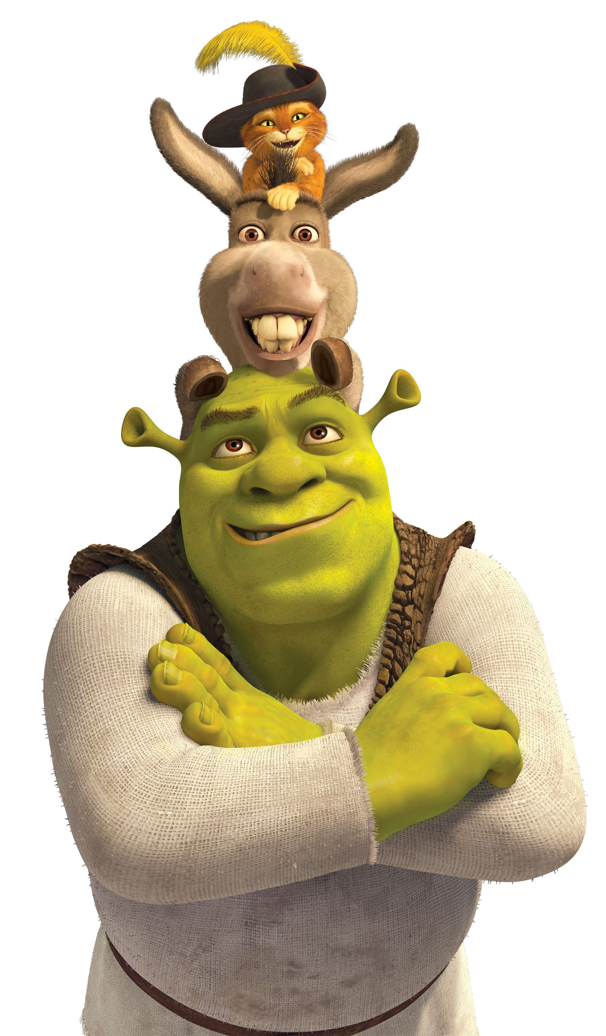
Back end progress…
Ability to process word.txt file
Generate random words
Navigate from start page to game page
Basic Python skeleton
Back end designers:
Logan Schlick
Kyle Rimando

